Slide 1

Context-Aware Testing System for Financial Ecosystem
AI-Powered Testing for Financial Stability
Team - TestGenie
Amiya Kumar Sahu
Prameela Tulugu
Snehanjali Rowlo
Sudeepa R
Tejaswini K

Slide 2
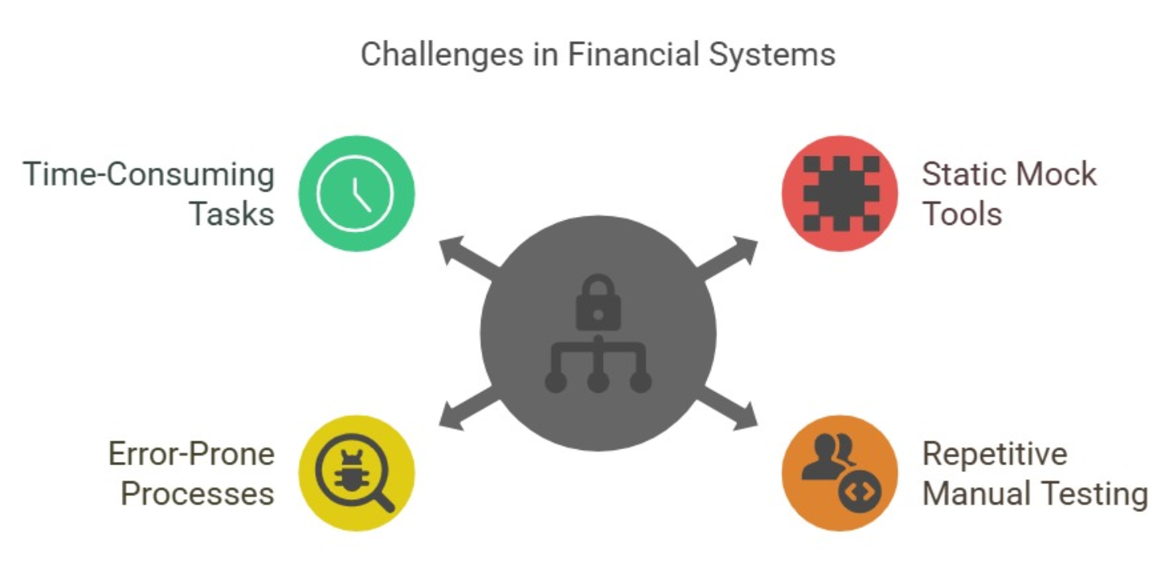
Problem & Challenges in Financial Software Testing
🚨 The Problem
Financial institutions face difficulties in testing complex, interconnected systems and APIs. Traditional static mock tools are inefficient, costly, and lack adaptability.
📉 Challenges
🔹 ⏳ Time-Consuming & Error-Prone – Banking software testing is slow and prone to human mistakes. 🔹 🐞 Missed Edge Cases – Manual test case creation increases the risk of missing critical scenarios. 🔹 ⚖️ Compliance Failures – Delays and errors impact regulatory adherence and software releases.
⚡ Our Inspiration
✅ AI-driven automation generates instant, accurate test cases and good coverage. ✅ Testers focus on strategy, not repetitive tasks.

Slide 3
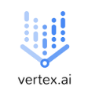
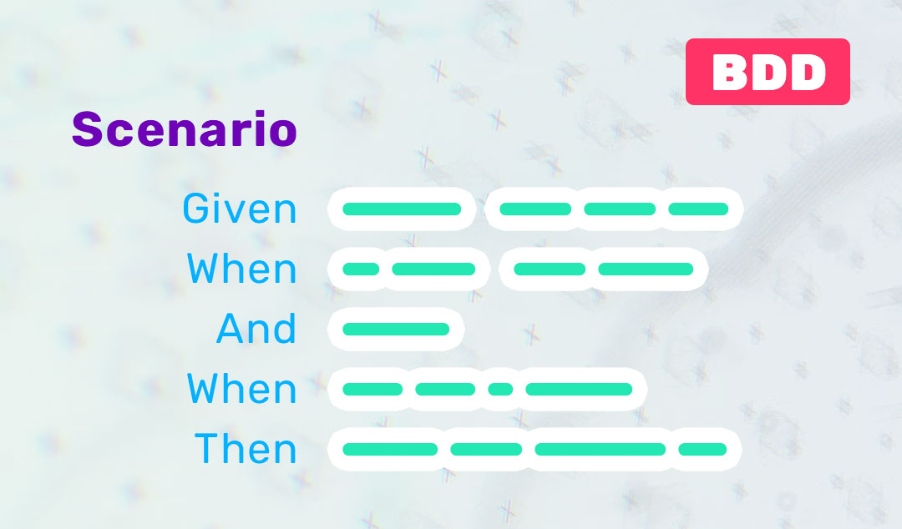






Architecture
Presentation Layer | Application Layer | Service Layer | Data Layer
1
2
3
4
5
9
8
7
6
User Input: The user enters Jira details (Title, ID, Description, Acceptance Criteria) in the browser form.
Form Submission: The browser sends a POST request to Flask’s / endpoint with form data.
Generation Trigger: Flask processes the request, passing data to the Python backend.
AI Call: Gemini Client sends a combined prompt (system prompt + user input) to Vertex AI, authenticated via Google Cloud SDK.
Gherkin Output: Vertex AI returns Gherkin-formatted test cases (e.g., "Given, When, Then" scenarios).
File Creation: The Python backend saves the test cases as a .feature file in downloads/ (e.g., JIRA-123.feature).
Response: Flask returns a JSON response with the file URL (/download/JIRA-123.feature).
UI Update: The browser displays a success message and enables the "Download" button.
Download Request: The user clicks "Download," triggering a GET request to /download/<filename>.
File Delivery: Flask serves the .feature file from downloads/.
File Received: The browser downloads the file for the user.

Slide 4

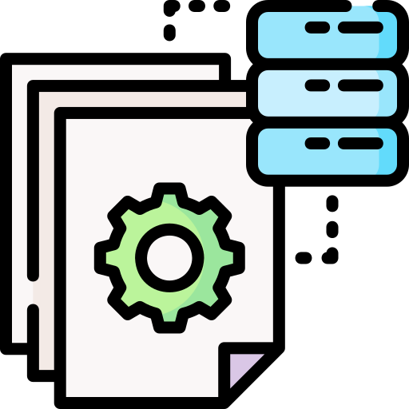

TestGenie: How It Works
The user enters Jira details (Title, ID, Description, Acceptance Criteria) in a browser form, which sends a POST request to the Flask backend. Flask processes the request and triggers AI-powered test case generation via the Python backend.
The Gemini Client creates a prompt using system instructions and user input,
then sends it to Vertex AI via Google Cloud SDK.
Vertex AI generates Gherkin-formatted test cases and returns them to the backend,
where they are saved as a .feature file in the download's directory.
Upon successful file creation, Flask responds with a JSON payload containing the file URL.
The browser then updates the UI, displaying a success message and enabling the "Download" button. When the user clicks "Download," a GET request is sent to the backend, which serves the .feature file. Finally, the browser downloads the file, making it accessible to the user.

Slide 5

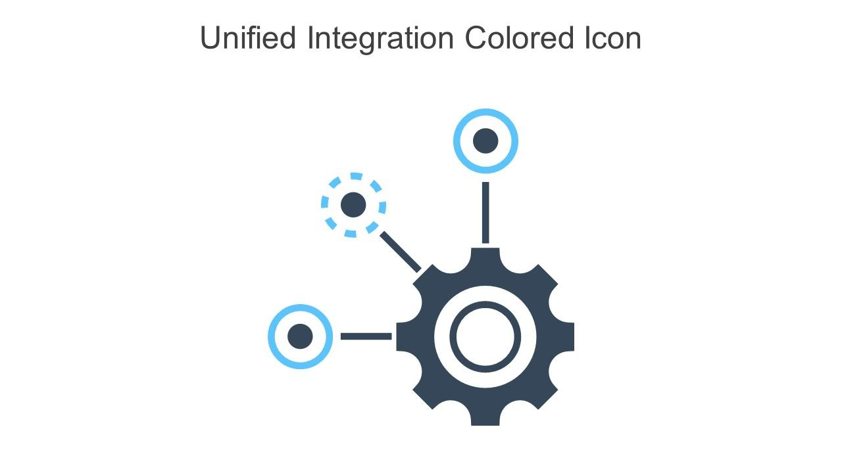
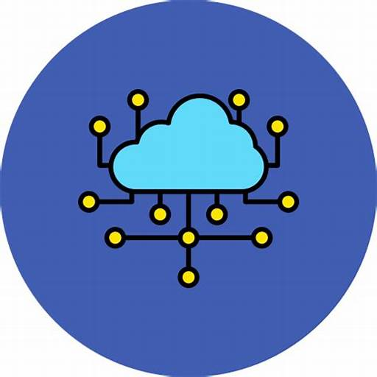



Advantages
Automated Test Case Generation – Reduces manual effort by leveraging AI to create
structured Gherkin test cases dynamically.
Seamless Jira Integration – Allows users to input Jira details directly, ensuring test cases align with project requirements.
Scalability & Cloud Support – Uses Vertex AI and Google Cloud SDK for secure and scalable AI processing.
User-Friendly Experience – Provides a simple UI with instant feedback, success messages, and easy file downloads.
Faster Testing Process – Enhances efficiency by generating, saving, and delivering
test cases in real-time.
Consistency & Accuracy – Standardized Gherkin format eliminates human errors
and maintains consistency in test cases.

Slide 6
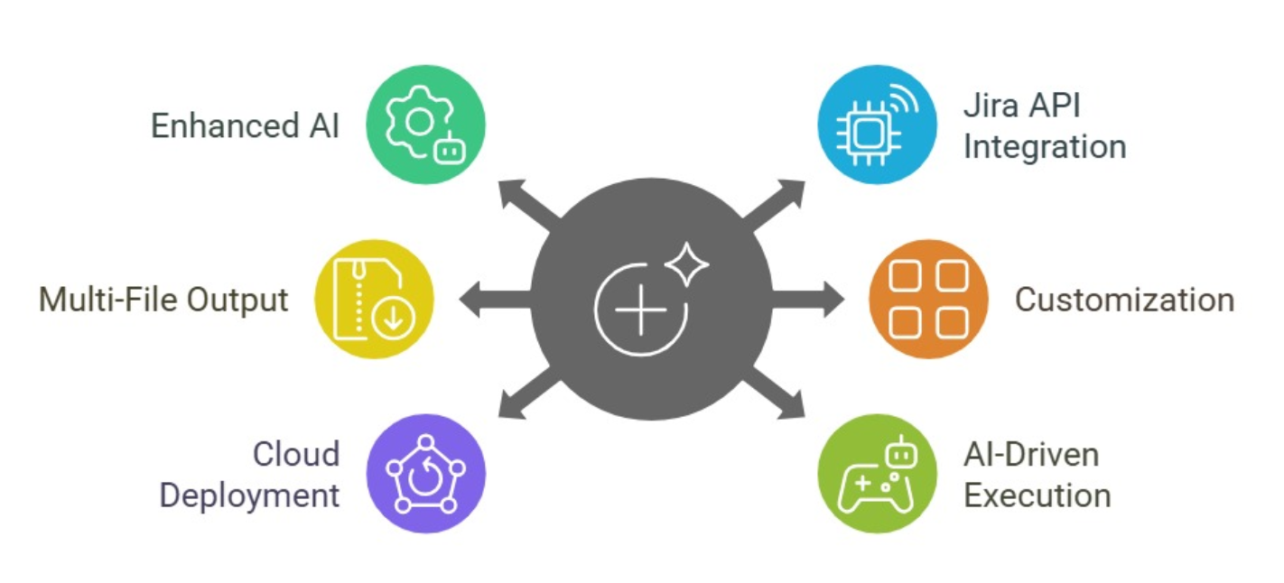
Future Roadmap
Enhanced AI – Integrate a production-ready model for generating more robust and diverse test cases.
Jira API Integration – Enable direct authentication and seamless feature import.6
Multi-File Output – Support ZIP file generation for bulk test case downloads.
Customization – Allow user-defined templates and banking-specific rule configurations.
Cloud Deployment – Deploy a scalable solution on GCP for enhanced accessibility and performance.
AI-Driven Test Execution & Validation - Enable AI to execute Gherkin-based test cases across different banking systems.

